Slide 1
Mixing Consoles

Slide 2
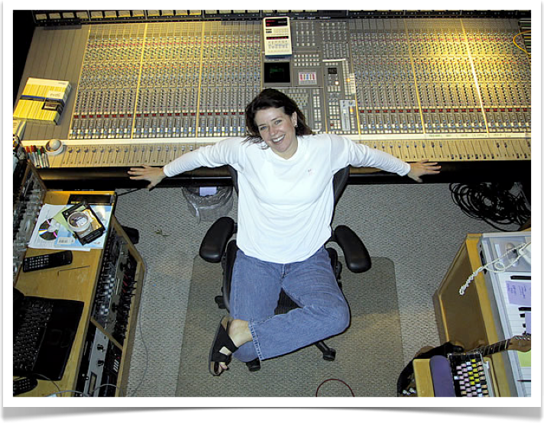
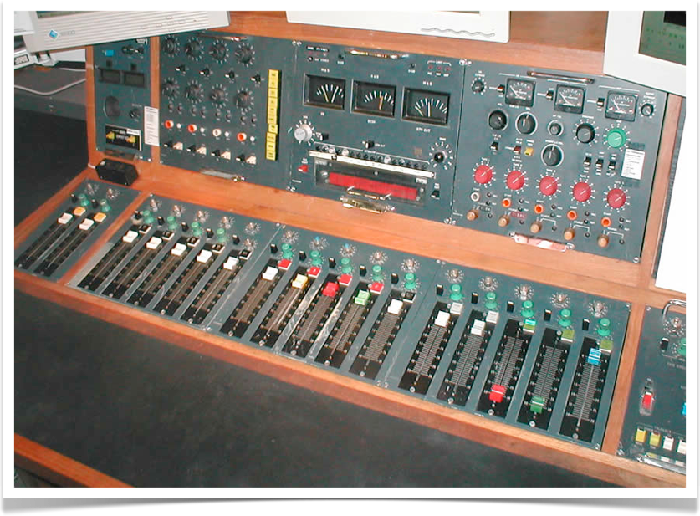
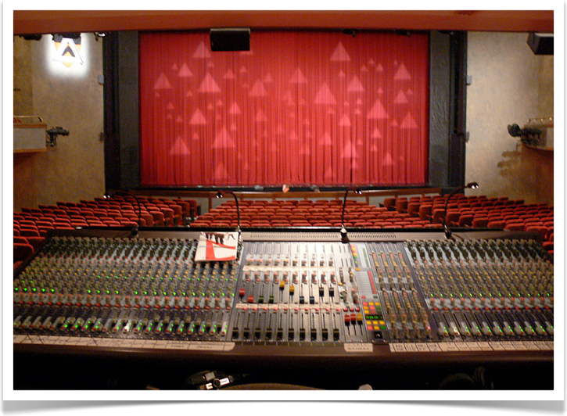
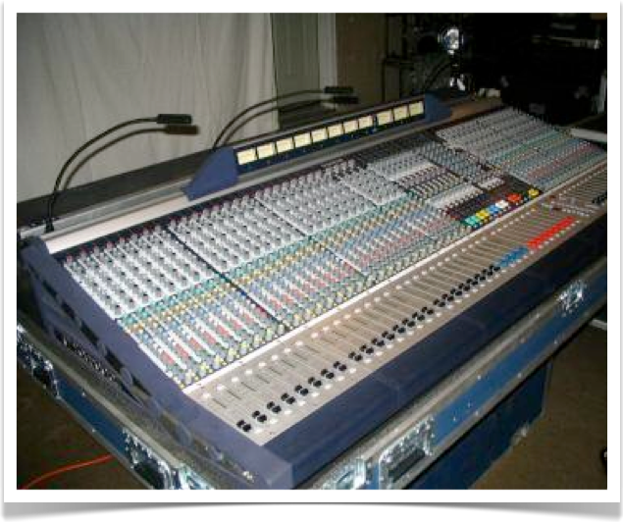

Slide 3
Mixing console overview
Mixing console/mixing desk/audio mixer
Device for combining, routing, and modifying audio signals
Analog or digital signals, depending on type
Modified signals summed to produce output
Main functions
Summing: combining audio signals
Many channels summed to stereo or mono via mix bus
Processing: modifying audio signal properties
Consoles often have on-board equalisers and dynamics processors
Routing: grouping, sending and receiving signals
Enable use of external processors and effects
Insert points, auxiliary sends and receives

Slide 4
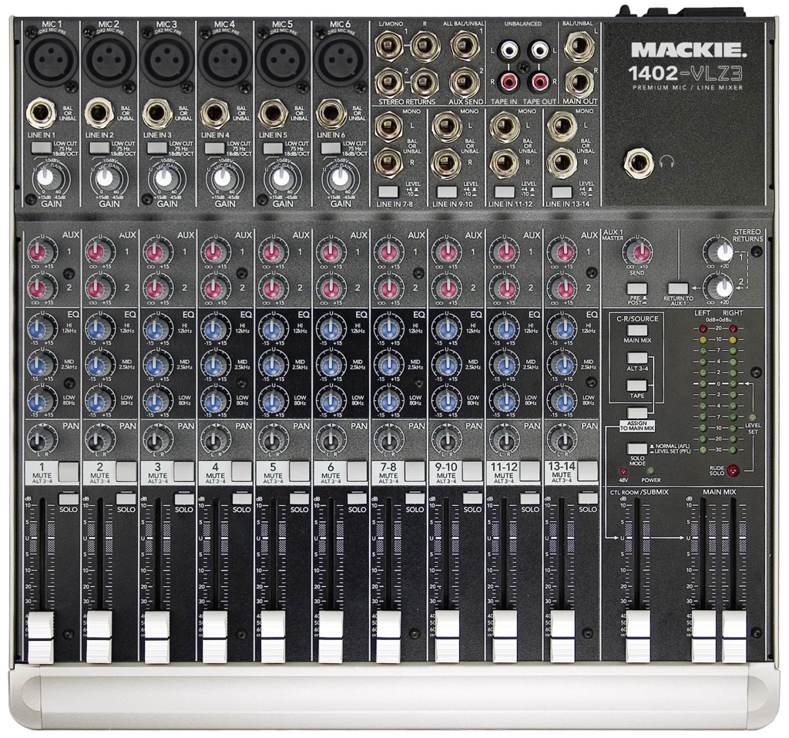
What’s going on here??

Slide 5
Two main sections
Channel section
Collection of channels organised in physical strips
Each channel corresponds to individual track on multitrack recorder
Most channels support mono input; some support stereo
Some channels will have different types of equalisation, etc.
Master section
Central control over console (global functionality)
Includes master aux sends, effect returns, control room level, ...

Slide 6
Channel
Master

Slide 7
A simple channel strip having only a cut control, a panning knob and a level fader, and corresponding signal flow diagram.
Cut
Panning
Fader
Output
Input
G_{L}
y_{L}[n]
x[n]
G
G_{R}
y_{R}[n]
Cut
Fader
Panning

Slide 8
Channel strip and associated block diagram, with additional controls
Gain
Cut
Clipping
Indicators
Thresh.
Ratio
Attack
Release
φ
Peak/RMS
Polarity
Compressor
Gain
Gain
Freq
Freq
Low shelf
Q
Low-mids
dynamics (compressor) and frequency (parametric equalizer) processing
Gain
Freq
Gain
Q
Freq
Fader
Mid-highs
High shelf
Parametric EQ
Inserts
Panning
Output
Input
G_{L}
y_{L}[n]
x[n]
Phase
Gain
+/−1
EQ
Compressor
G
G_{R}
y_{R}[n]
Cut
Fader
Clipping
Indicator
Insert
Panning

Slide 9
Signal flow diagram and user interface for simple mixing console with 4 channels and a master section.
x₁[n]
Channel strip
y_{L}[n]
G
x₂[n]
Channel strip
x₃[n]
Channel strip
G
y_{R}[n]
x₄[n]
Channel strip
Summing
amplifier
Master
Fader
Cut
Cut
Cut
Cut
Master
Fader
Meter
1 2 3 4
Channel Section
Master Section

Slide 10
About our simple console
Each channel has its own controls; fader, pan pot, cut (mute) switch…
Line gain: boost or attenuate level before signal enters channel path
Phase invert: flips sign (polarity) of signal
Clip indicators: show when signal exceeds a threshold (red)

Slide 11
Busses
Buss or bus
common signal path to which many signals can be mixed
Summing amplifier used to combine multiple sources
On typical large console:
Mix buss
Group busses
Auxiliary busses
Solo buss

Slide 12
On-board processors
Most consoles offer some on-board processing for each channel
Basic tone controls
Filter section
Dynamics section
For example:
Processors in signal path between phase and cut stages
High pass filter, equaliser, basic compressor

Slide 13
Insert points
External processor
External processor
Signal flow
Insert
send
Insert
return
Insert
send
Insert
return
Insert
Insert
Insert external device into signal path
Breaks signal path
Diverts existing signal to external device
Return allows externally processed signal to replace original
Most consoles send signal to insert send socket
Insert button determines whether return replaces original
engaged

Slide 14
Auxiliary sends
Aux send: Copy signal and route to internal auxiliary buss
Buss routs to output socket
Can feed external effect unit
Each channel strip has set of controls related to aux send
Level control
Pre/post fader switch
Pan control
On/off switch
Can send each channel to same aux buss
Insert sends: 1 ch. per effects unit
Aux sends: share effects between ch.
Aux 1 Bus
Channel
fader
Local aux
send level
Cut
Master aux
send level
Aux 1
Send output
Channel
fader
Local aux
send level
Signal flow for auxiliary sends

Slide 15
FX returns
Sometimes called aux returns
Stereo inputs that can be routed to mix buss
Often with dedicated mute and level controls
When there are free channels
Can bring back effect into channel rather than FX return
Channels offer more processing options

Slide 16
Control groups
Two types of groups: control and audio
Control groups
Allocate a set of channels to control simultaneously
Moving one fader moves all others automatically
Audio signals are still separate (no alteration of signal path)
Audio groups
Subgrouping
Sum group of audio signals to group buss
Acts as submix that can be processed and routed to main mix buss
Used to handle many audio signals collectively
Group busses are mono
Often used together in stereo pairs
Consoles can be described by the format channels : groups : mix-busses

Slide 17
Audio groups
Routing matrix on channel strip assigns channel to groups
Located vertically next to fader or separate collection of buttons
Routing matrices come in two formats
Independent button for each group buss or
Button for each (stereo) pair of groups
1
2
5-6
3
4
3-4
5
6
1-2
L/R
L/R

Slide 18
Terminology: effects and processors
Distinction made by audio recording engineers
Effects are
Added to original signal
Encompass dry and wet sounds that can be mixed
Dry: original sound
Wet: processed sound
Often delay-based
Reverb, echo, chorus, flanging
Processors
Change whole of a signal
Generally do not mix with original
Compressors, gates, equalisers
Distinction often blurred
We treat them all as digital audio effects
75%
Dry
Wet
Notes:
This is a distinction made by audio recording engineers, but not generally made by the audio signal processing community.

Slide 19
Effects and processors
Connection methods are generally different
Processors: connect using an insertion point
Effects: connect using an auxiliary send
However, there are exceptions
Effect
Notice dry/wet mix
(a)
Effect
Processor
Dry/wet mix not relevant
(b)
Processor

Slide 20
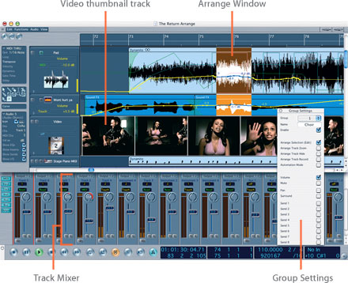
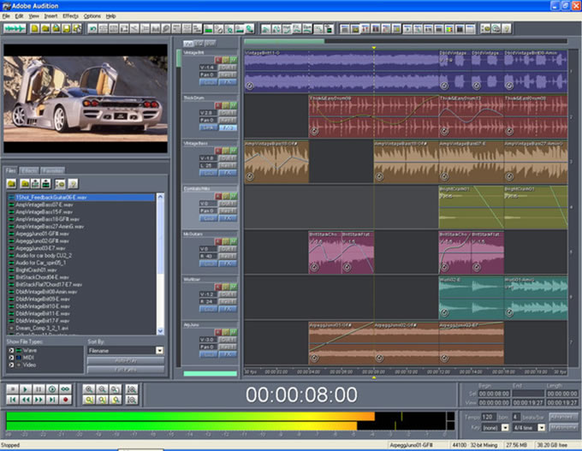
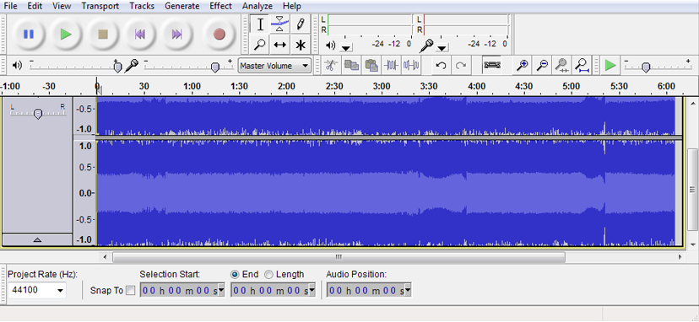
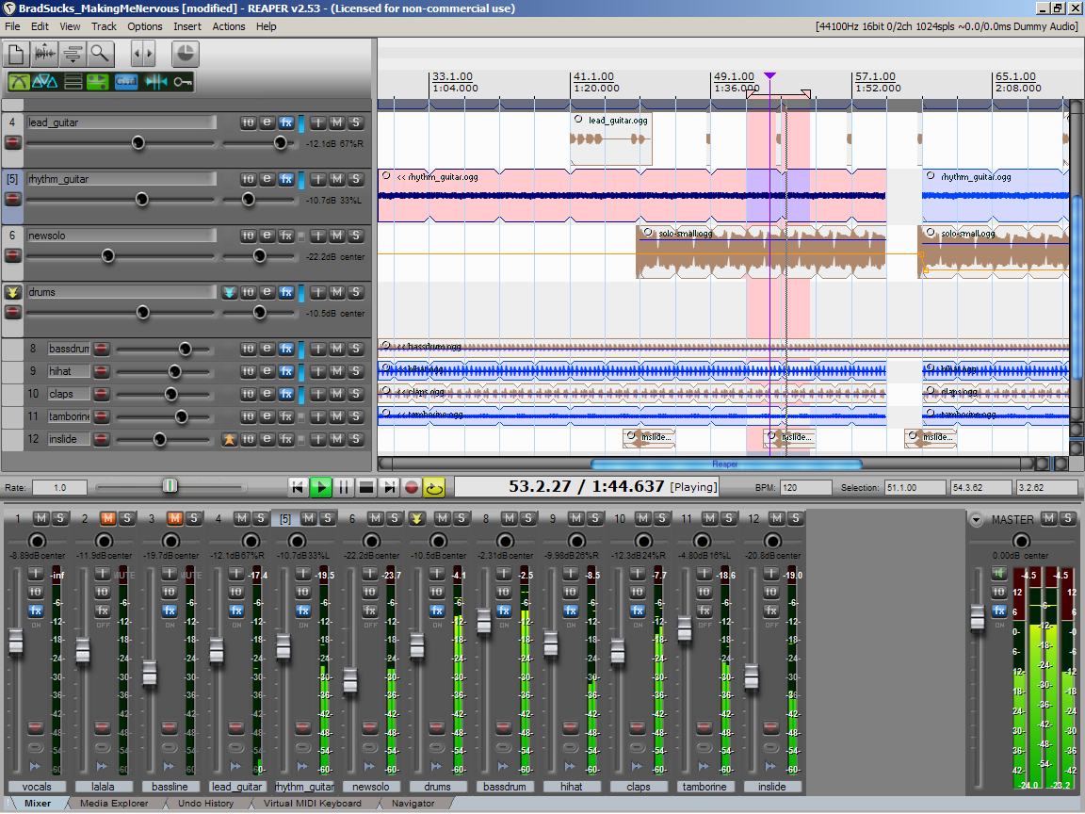
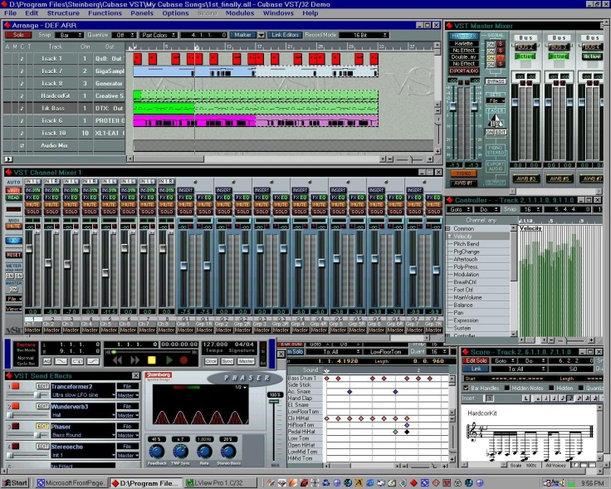
DAWs, software mixers and sequencers

Slide 21
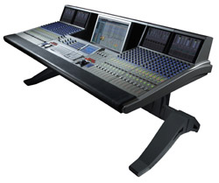
DAW – Digital Audio Workstation
Computer for editing, processing digital audio professionally
high-quality audio hardware
Multiple ADC/DAC
High-end Soundcard
Multitrack audio software
freely manipulate recorded sound
like word processor manipulates typed words
from 2-channel editor to complete digital recording studio
Computer-based DAWs
computer
host for sound card and software
provides processing power for audio editing
ADC-DAC sound card
audio interface
Convert analog into digital audio
assist in processing audio
digital audio editor software
controls hardware components
user interface to allow for recording & editing
Integrated DAWs
Mixing Console
Control Surface
Digital interface

Slide 22
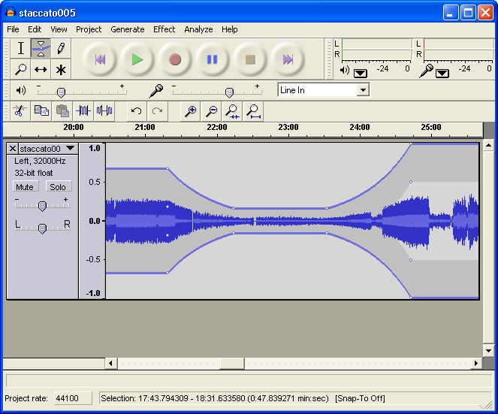
Screenshot of Audacity, a popular open source DAW

Slide 23
Computer DAW Functionality
Standard layout
Transport controls
Play, Rewind, Record, ...
Track controls
Mixer
Waveform display
Multitrack DAWs
Can operate on multiple tracks at once
Adjust overall volume, balance of all waveforms in track
Pan control adjusts balance between speakers
Plugins can be placed on a track to process the sound
Automation
Commonly performed through envelope points
Create and adjust multiple points along waveform
Specify parameters of sound over time
Each dot
represents
one envelope
point

Slide 24
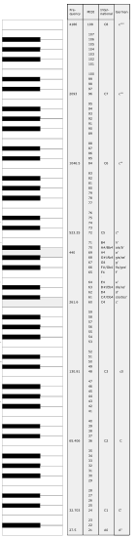
MIDI
Musical Instrument Digital Interface
Industry-standard electronic communication protocol (since 1983)
Serial interface (3.9 kBps) with defined set of messages
Defines each musical note in an electronic instrument
Allow instruments and computers to exchange data
MIDI does not transmit audio
Transmits digital symbolic information about a performance

Slide 25
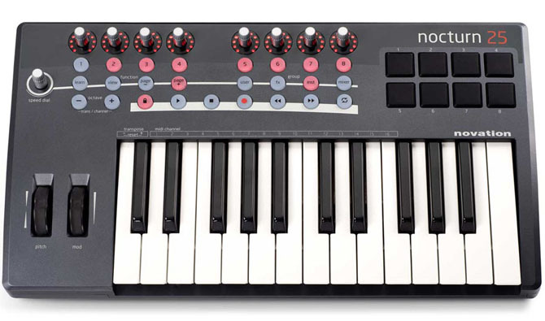
MIDI
Example MIDI messages
Control Change
Control #, Value
e.g. Modulation, Pan, Effect Levels
Pitch Wheel
Pitch value (up / down)
Note On / Note Off
Note #, Velocity

Slide 26
Sequencers
Program in computer or stand-alone keyboard
Record & edit musical performance without audio input
Performance recorded as MIDI events
What (virtual) instruments played
What note played, when, and how loud
How hard key was pressed (velocity)
When did sustain pedal (or other controls) get pressed
Data played back into MIDI synth or sound module
Can change sound without re-recording
e.g. select piano, later decide to change to organ
Multiple modules can use different MIDI channels
Layer sounds / instruments to create orchestra

Slide 27
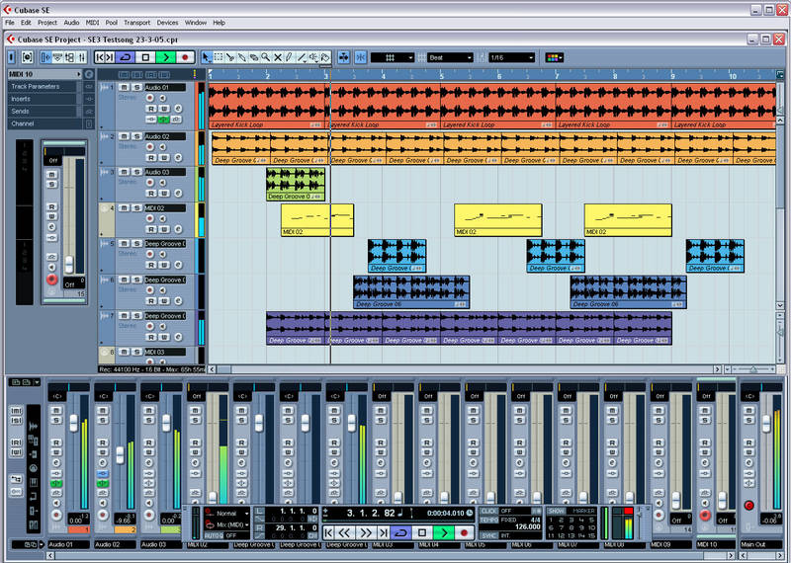
Sequencers
Most modern sequencers now feature audio editing and processing capabilities
Sequencers DAWs
Sequencer
in Cubase

Slide 28
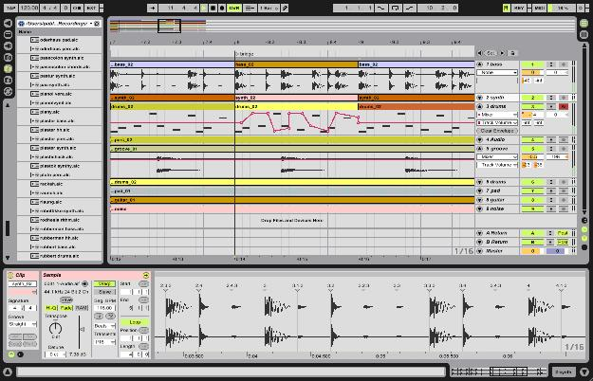
Sequencers
Some sequencers used for live performance as well as composing / arranging
Also precision mixing by DJs
Ableton
Live

Slide 29
Tracks and mixer strips
No separation between multitrack and the mixer
Multitrack represented as sequence window
Also known as arrangement, edit or project window
Shows tracks and audio regions
Lose the channels, just tracks and mixer strips
New track in sequence window creates a new mixer strip in mixer window
Mixer strips
Similar to channel strips on consoles
Have input
Signal flows through specific path
Routed to output

Slide 30
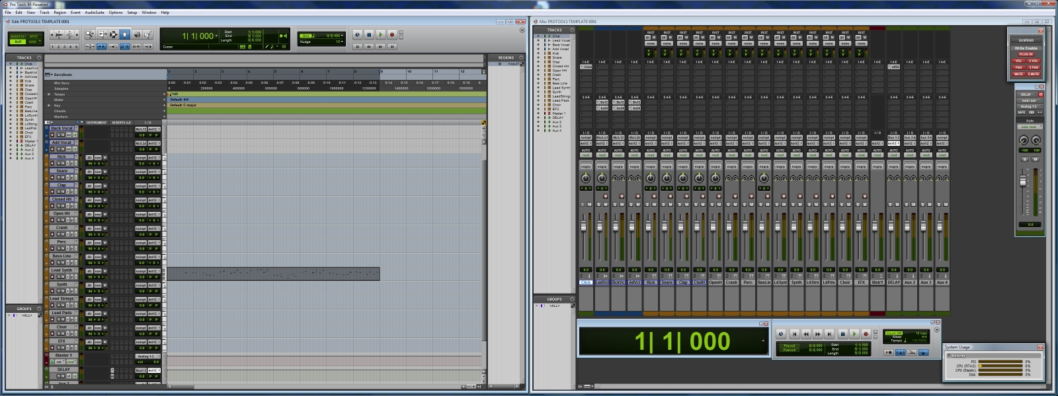
Tracks and mixer strips
Multitrack represented as sequence window
Shows tracks and audio regions
New track in sequence window creates a new mixer strip in mixer window
Sequence / Audio Editor Window
Mixer Window

Slide 31
Tracks
Audio: raw tracks and their audio regions
Aux
Audio grouping and to accommodate effects as part of an aux send
Sometimes called FX channel or group channel
Master: most commonly main stereo buss
In sequence window, these tracks only display automation data
MIDI: record, edit and output symbolic information
Sometimes used during mixing to automate external digital units or store/recall their state and presets
Might be used for drum triggering
Instrument: contain MIDI data
Converted to audio by virtual instrument
Look and behave like audio tracks
...

Slide 32
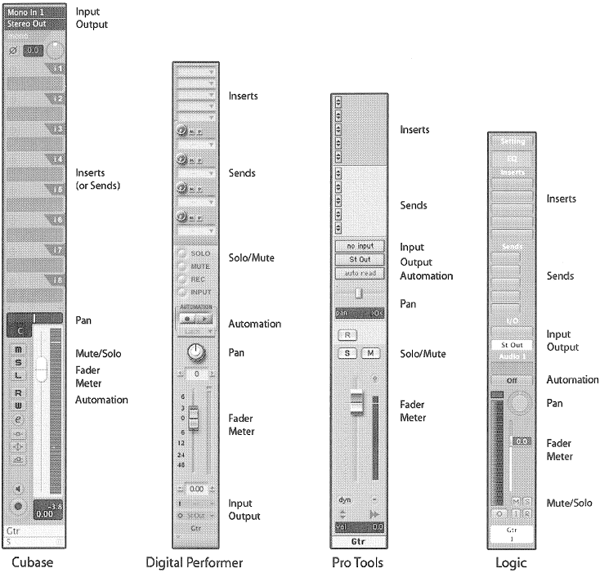
Mixer strips
Similar to channel strips on consoles
Have input
Signal flows through specific path
Routed to output
…
…
Cut

Slide 33
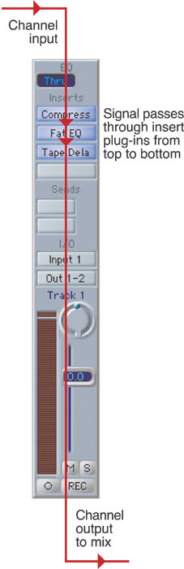
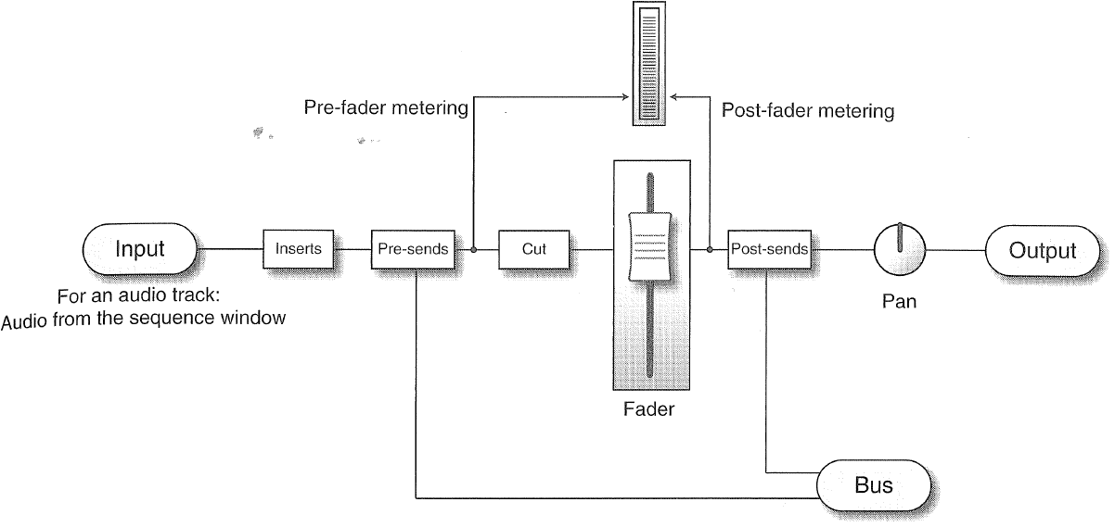
Mixer strips
Signal flow
Single line can denote mono or stereo path throughout

Slide 34
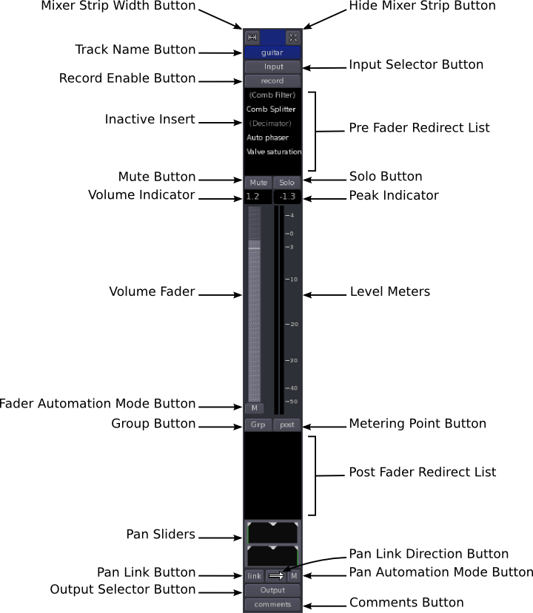
Mixer strips
Input selection
What signal feeds strip
Either busses or physical audio inputs
Audio strips fed from audio regions in sequence window
Output selection
Routes strip to buss or physical audio output
Inserts
Load plug-ins in series to signal path
Add effects and processors
Sends
Feed either pre-fader or post-fader signal to buss
Each send can be routed to different buss

Slide 35
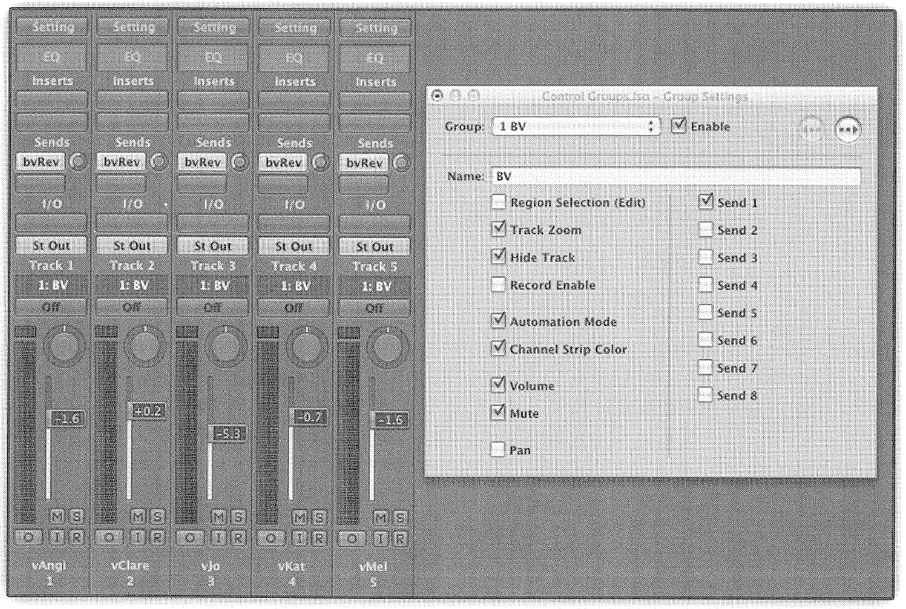
Control grouping
Each track can be assigned to 1 or more groups
Can select which properties to group
Much more functionality than mixing consoles

Slide 36
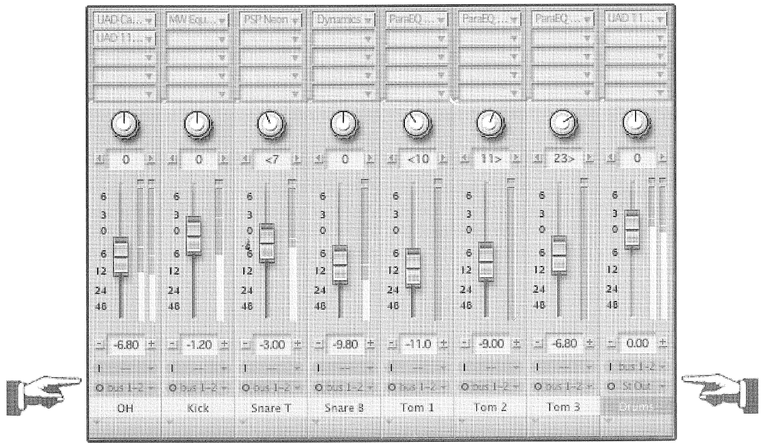
Audio grouping
Software mixers do not provide routing matrices
Set output of each included track to bus
Feed bus into auxiliary track
Process each track individually using inserts
Process audio group using inserts on aux track

Slide 37
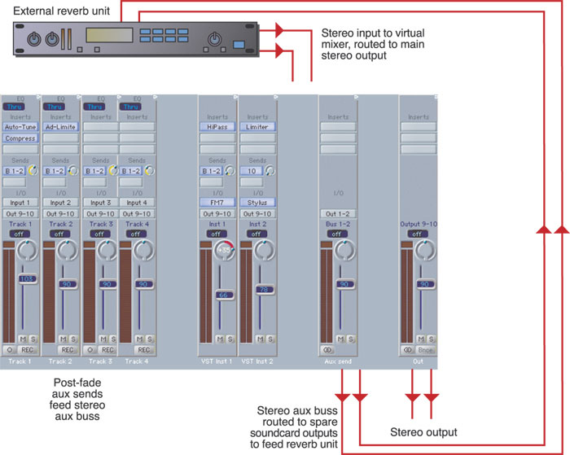
Sends and effects
Effects added using send
Tracks sent to buss
Buss fed to aux track
Effect plug-in loaded as insert on aux track
Aux track has output set to stereo mix

Slide 38
Recommended text
See Roey Izhaki’s Mixing Audio for an excellent discussion of mixing consoles and DAWs, their architecture and their use.

